Slide 1

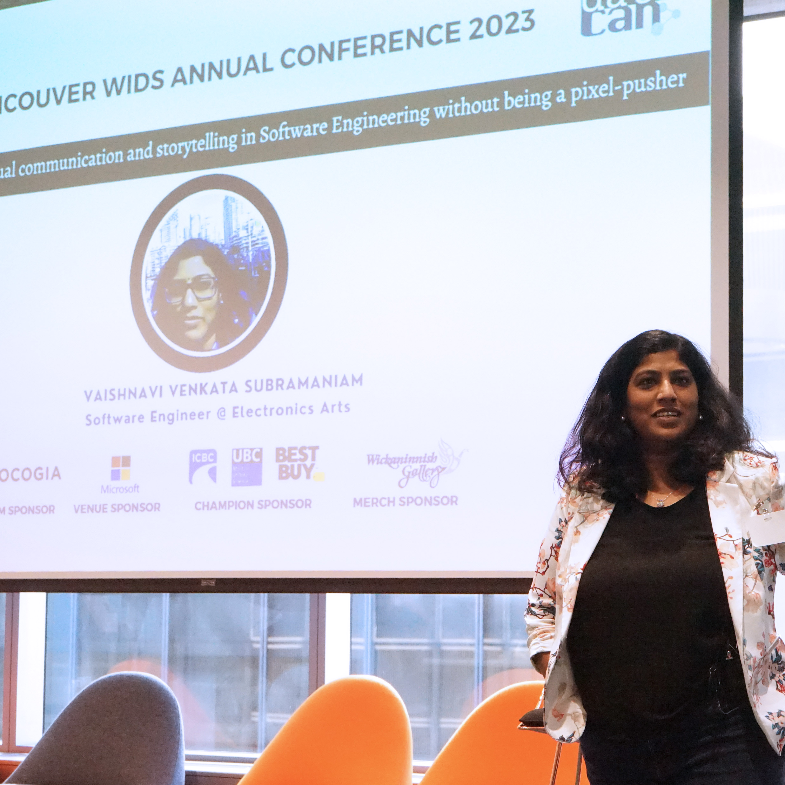

Integrating visual communication and storytelling in Software Engineering
Vaishnavi V
Solutions Architect | Code Wrangler

Slide 2
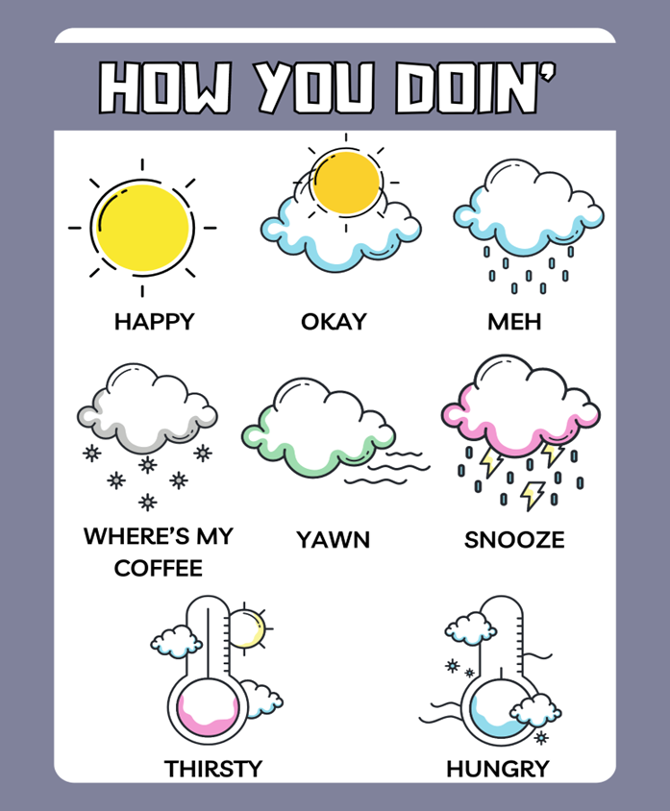
Notes:
Joey Tribbiani from the sitcom Friends

Slide 3
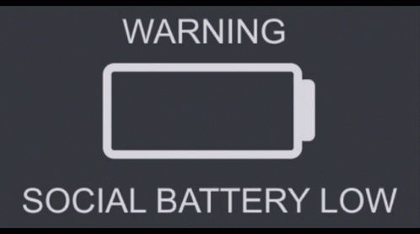
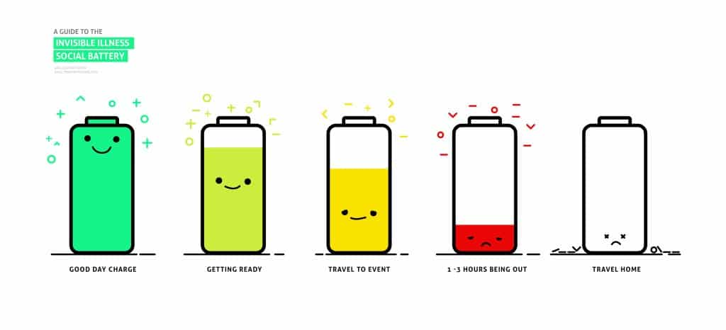

Slide 4


Slide 5


Disclaimer

Slide 6
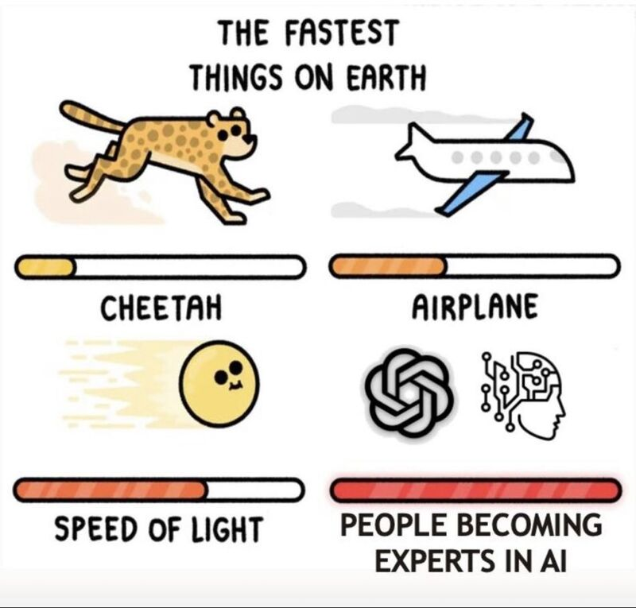
Not an expert!
Notes:
We're now witnessing the Dunning-Kruger effect in action and scale never seen before 😅
Remember - AI won't take your job but people who are "experts" in AI will 😉

Slide 7
Glossophobia

Slide 8


Slide 9
Presentation is auto biographical – Sample size of 1 No spandex required!

Slide 10
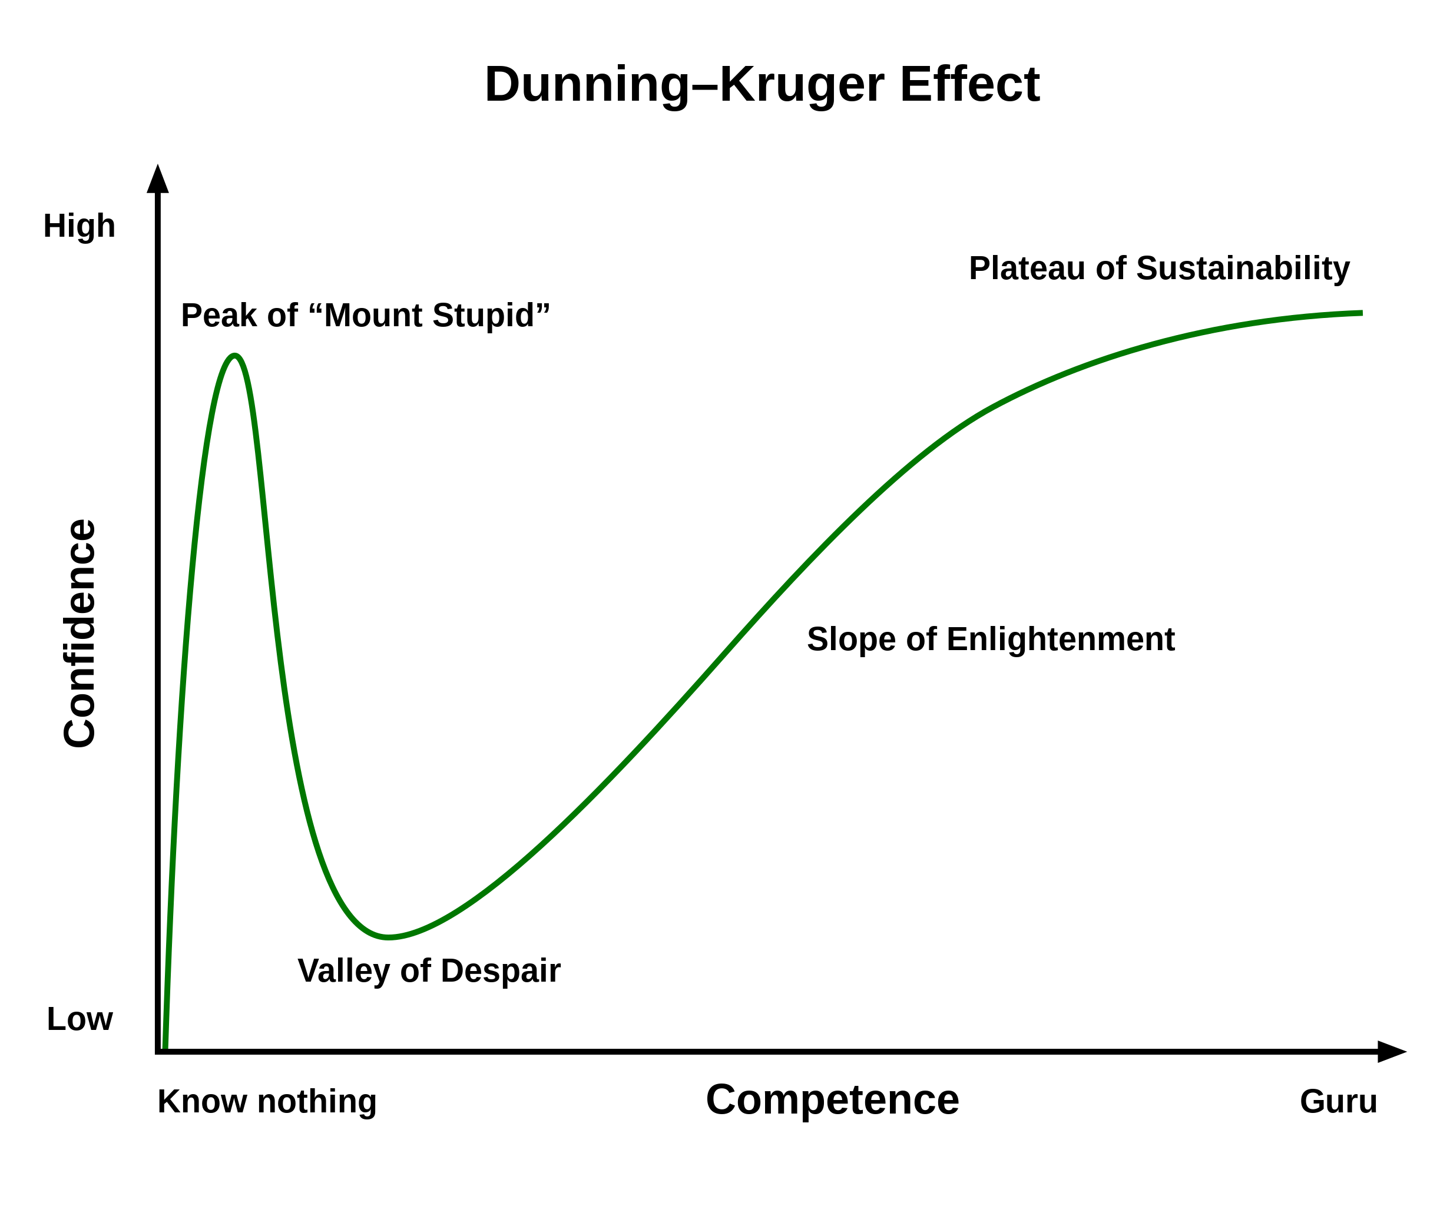

Slide 11
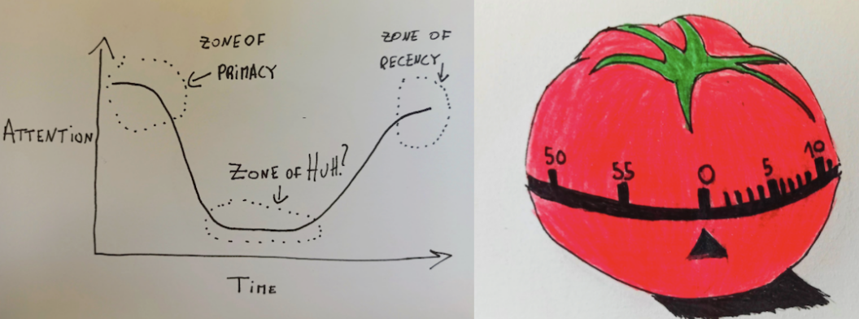
Attention Span
Source : https://semaphoreci.com/blog/storytelling-programming
Notes:
When we perform a task, like learning for an exam, our level of attention varies:
Zone of Primacy: our attention level is high (first 20 minutes)
Zone of Huh: our attention level is low (unlimited)
Zone of Recency: our attention level is high again (last 5 minutes)

Slide 12
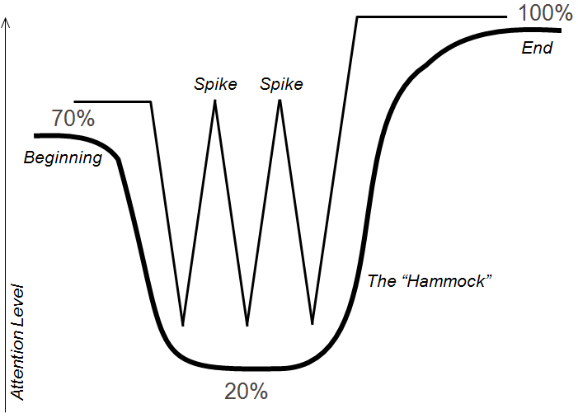
Human attention : The Hammock and the Spikes
Source : Keeping the Audience Engaged with Presentation “Spikes”
Notes:
When we perform a task, like learning for an exam, our level of attention varies:
Zone of Primacy: our attention level is high (first 20 minutes)
Zone of Huh: our attention level is low (unlimited)
Zone of Recency: our attention level is high again (last 5 minutes)

Slide 13
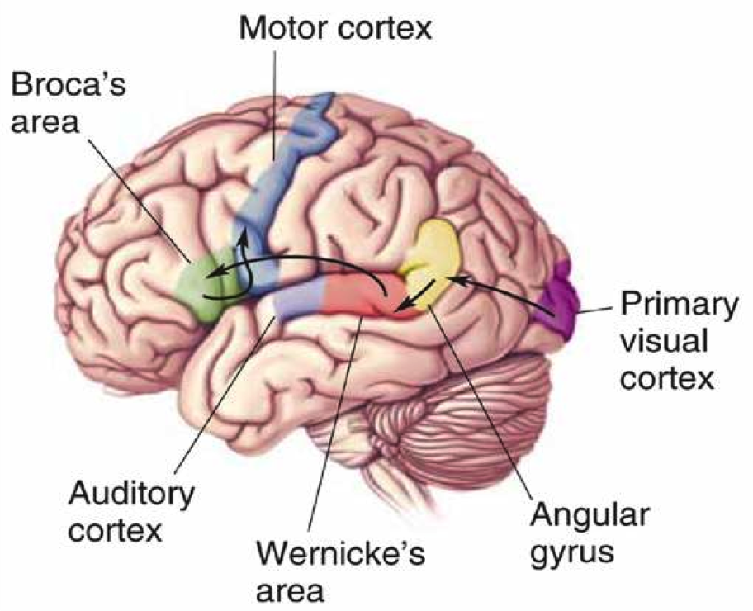
Visual information vs reading words
Notes:
The part of the brain that processes visual information (the visual cortex) is much larger than the part of the brain responsible for reading words (the broca). By providing your information in a visual presentation, you make it much easier on your team to process the information effectively.

Slide 14
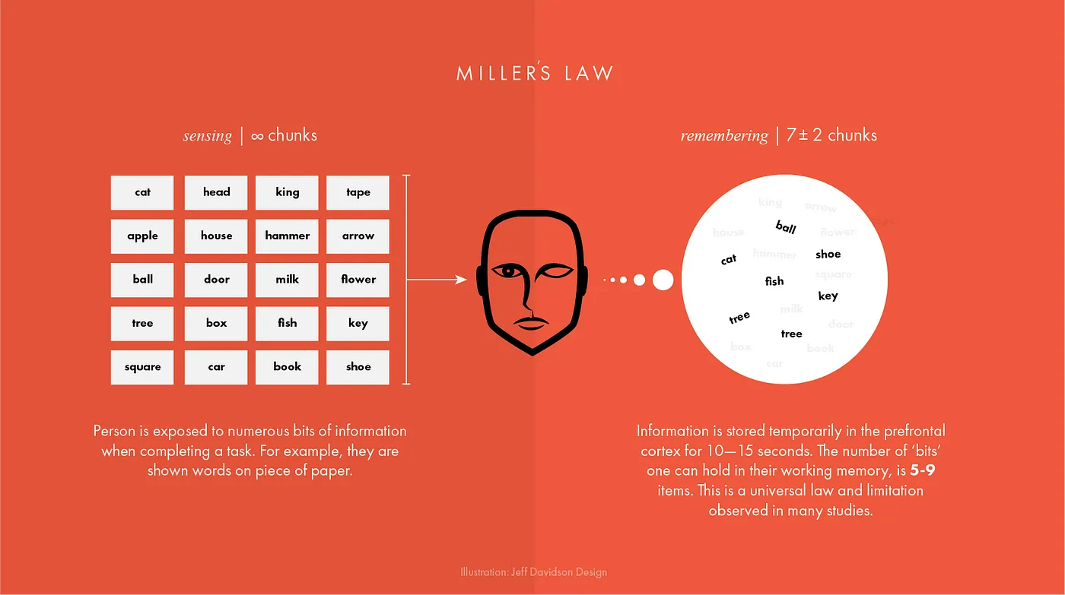
Unique
Tested
Telling stories through visuals and data
Elephant
Authentic
Harnessing color to illustrate importance and attract attention
Creating more memorable information through the use of symbols and icons
Notes:
The first concept is "chunking" and the capacity of short term memory. Miller (1956) presented the idea that short-term memory could only hold 5-9 chunks of information (seven plus or minus two) where a chunk is any meaningful unit. A chunk could refer to digits, words, chess positions, or people's faces. The concept of chunking and the limited capacity of short term memory became a basic element of all subsequent theories of memory.

Slide 15
George Miller’s Magical Number of Immediate Memory
Unique
Tested
Showing the impact of your work by using data visualization
Telling stories through visuals and data
Elephant
Authentic
Creating more memorable information through the use of symbols and icons
Harnessing color to illustrate importance and attract attention
Notes:
Humans are visually oriented animals with approximately 55% of our cortex is dedicated to processing visual stimuli.
The first concept is "chunking" and the capacity of short term memory. Miller (1956) presented the idea that short-term memory could only hold 5-9 chunks of information (seven plus or minus two) where a chunk is any meaningful unit. A chunk could refer to digits, words, chess positions, or people's faces. The concept of chunking and the limited capacity of short term memory became a basic element of all subsequent theories of memory.

Slide 16

Definition
Visual communication is the practice of using visual elements to get a message across, inspire change, or evoke an emotion.

Slide 17
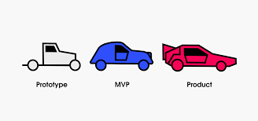
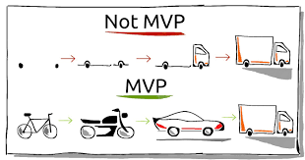
Perfect MVP
Communication design refers to crafting a message that educates, motivates, and engages the viewer.
Graphic design uses design principles to communicate that message in a way that is clear and eye-catching to the intended audience.

Slide 18
Z73. 0
Notes:
The repository on GitHub states that the name "996. icu" refers to how developers who work under the 996 system (9AM–9PM, 6 days per week) would risk poor health and a possible stay in an intensive care unit. The movement's slogan is "developers' lives matter".

Slide 19
996. icu
Notes:
The repository on GitHub states that the name "996. icu" refers to how developers who work under the 996 system (9AM–9PM, 6 days per week) would risk poor health and a possible stay in an intensive care unit. The movement's slogan is "developers' lives matter".

Slide 20
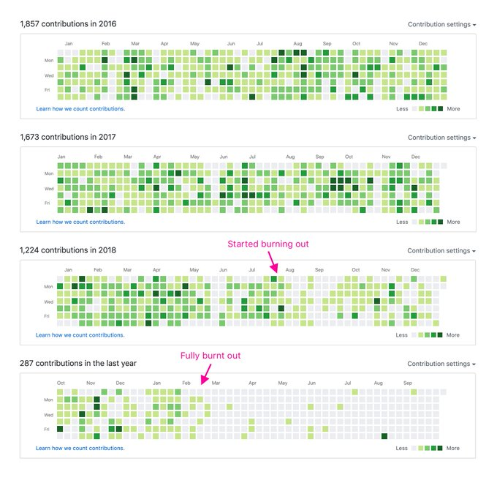
Visualizing burnout
Credits : Jonnie Hallman

Slide 21
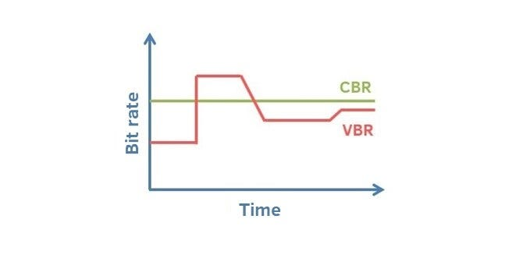
Crest and trough

Slide 22
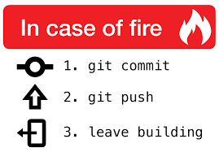
Tell, Don’t Ask
“Programs must be written for people to read, and only incidentally for machines to execute” (SICP)*
Structure and Interpretation of Computer Programs

Slide 23
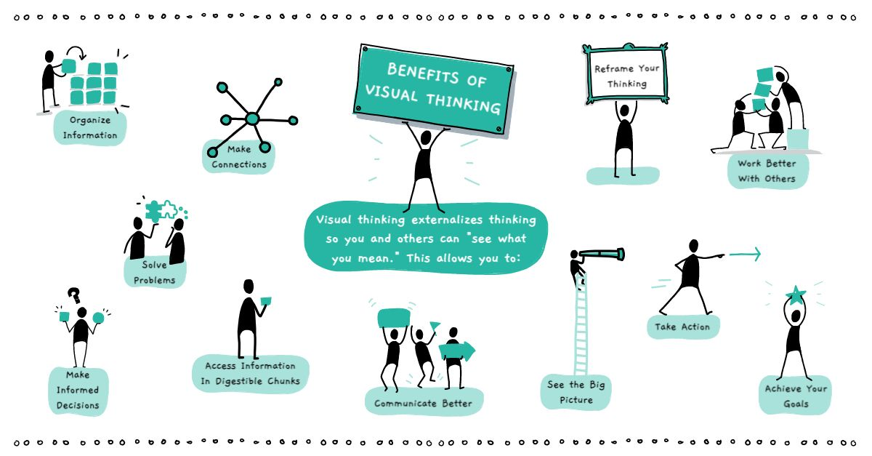
Definition
Visual communication is the practice of using visual elements to get a message across, inspire change, or evoke an emotion.
Source : Drawify

Slide 24

Examples

Slide 25
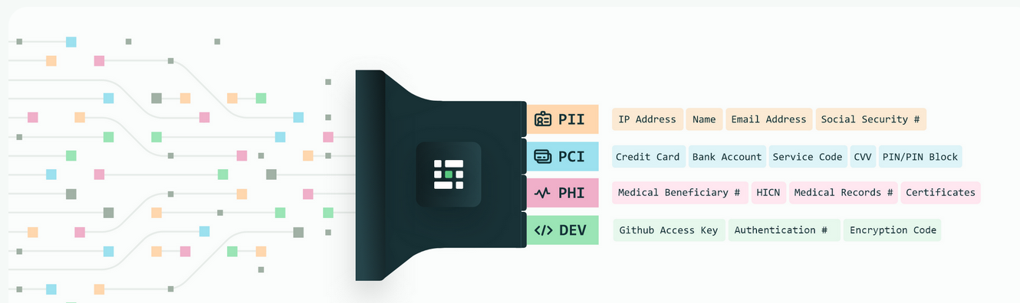
Privacy
Source : Medium blog
Notes:
Personal Identifiable Information (PII) is defined as: Any representation of information that permits the identity of an individual to whom the information applies to be reasonably inferred by either direct or indirect means.

Slide 26
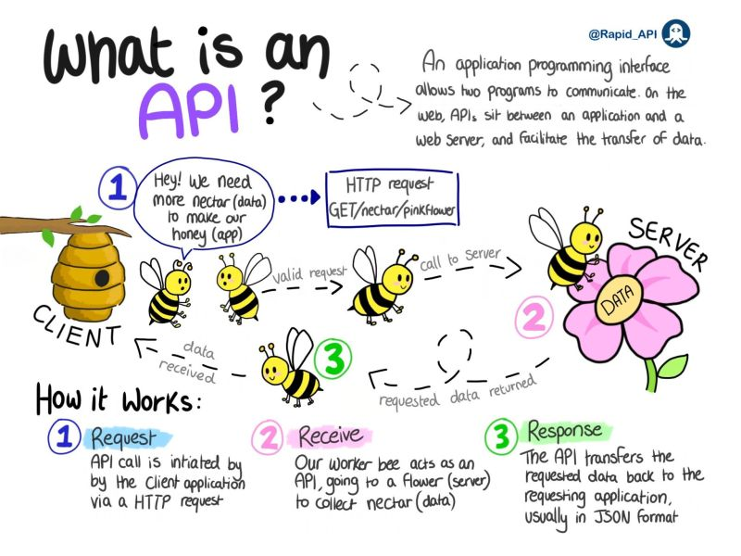
Source :
Notes:
Personal Identifiable Information (PII) is defined as: Any representation of information that permits the identity of an individual to whom the information applies to be reasonably inferred by either direct or indirect means.

Slide 27
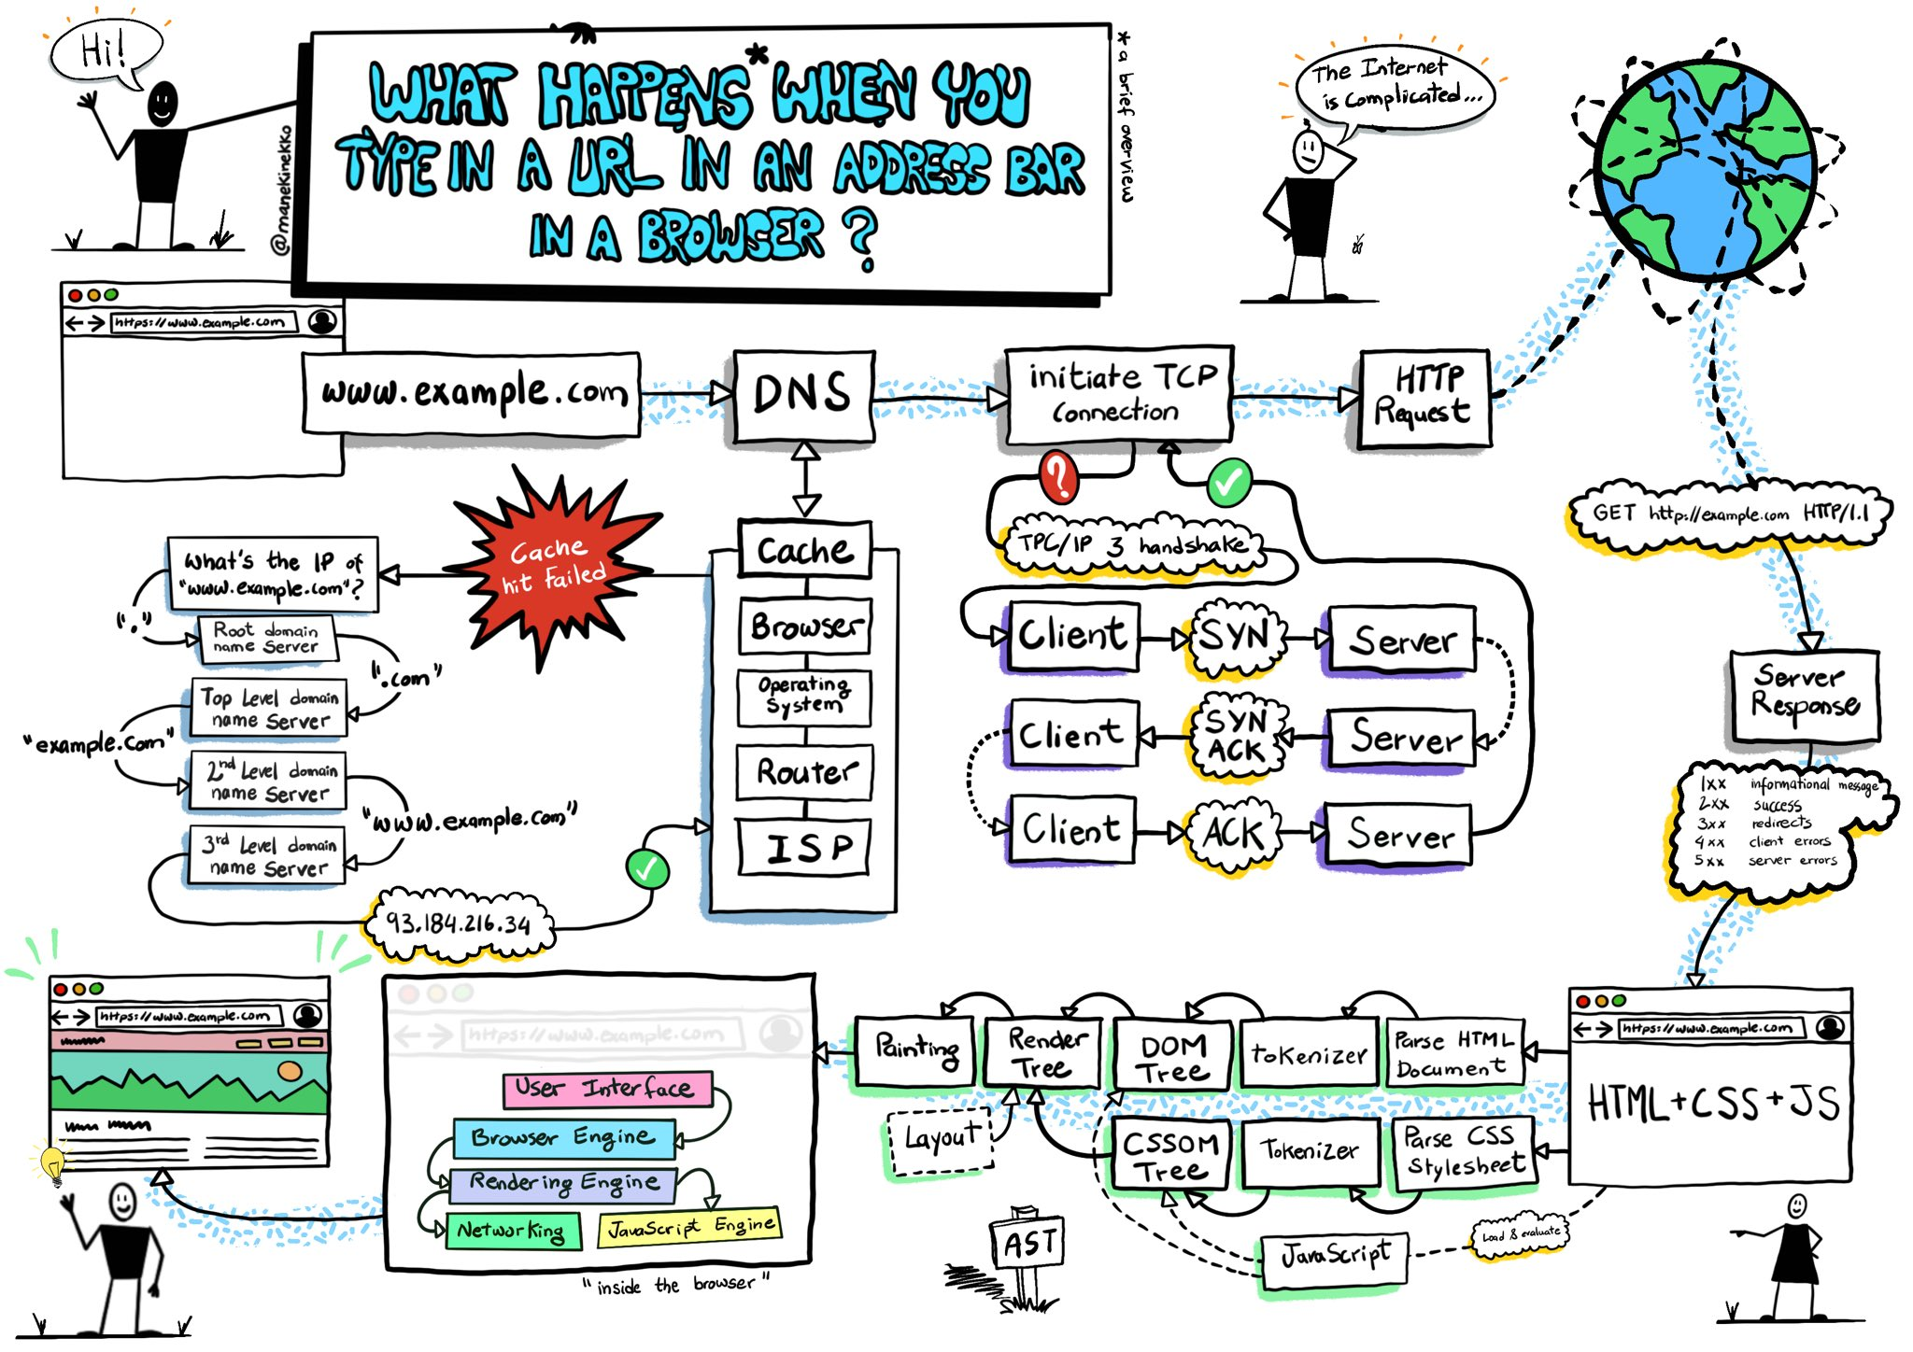
ELI5
Source :Wassim Chegham
Notes:
Personal Identifiable Information (PII) is defined as: Any representation of information that permits the identity of an individual to whom the information applies to be reasonably inferred by either direct or indirect means.

Slide 28
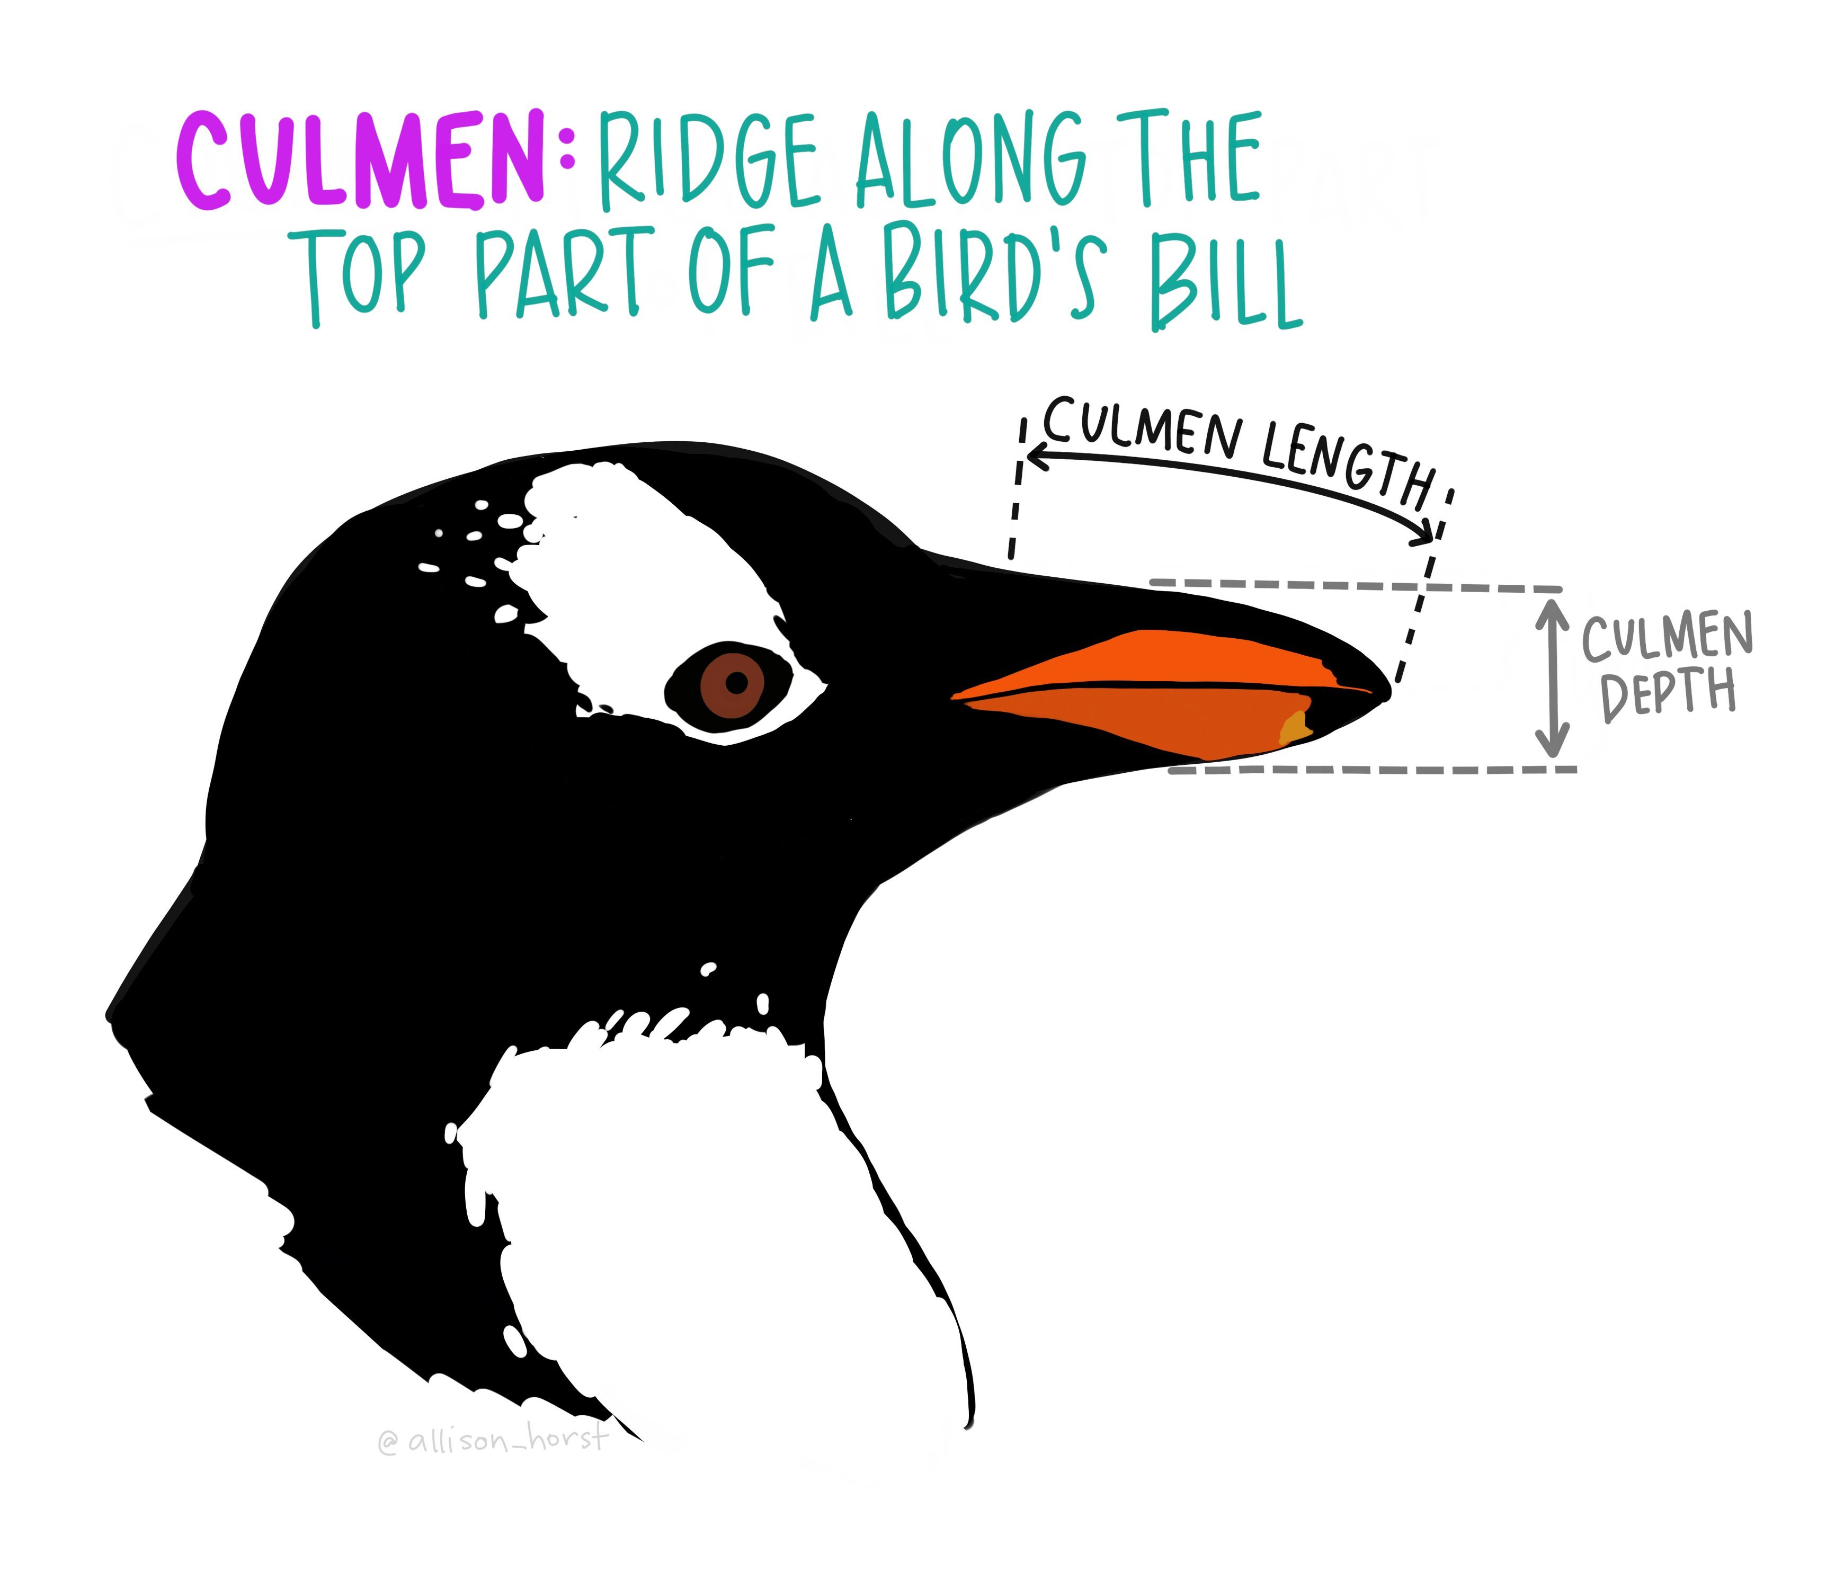
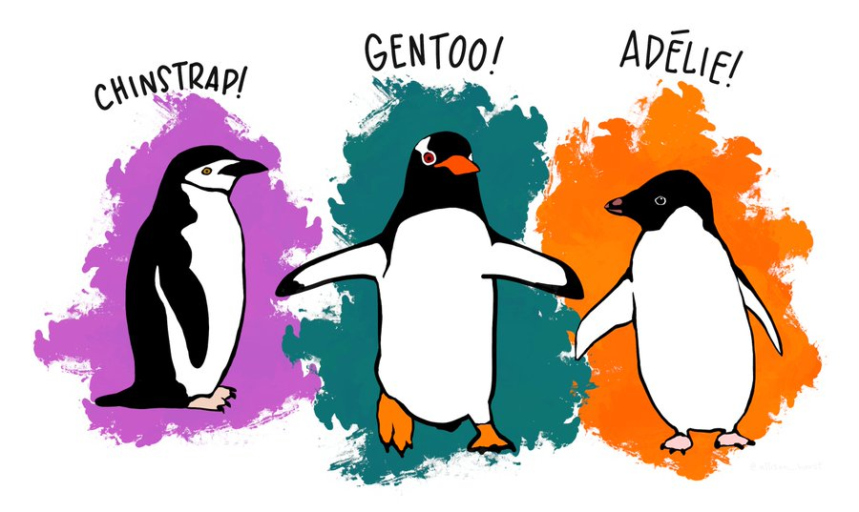
Penguin Dataset
Goal
Determine the species of a penguin
Parameters :
• Culmen length
• Culmen depth
• Flipper length
• Body mass
Source : Twitter

Slide 29
Manual Of Me

Slide 30


Slide 31
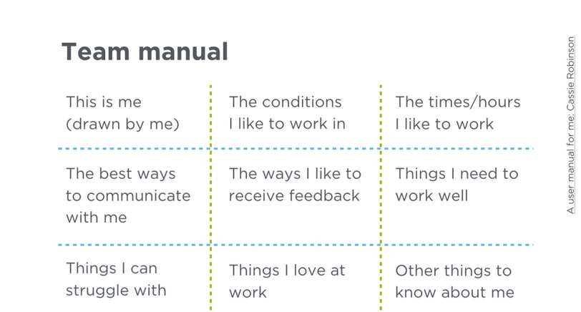

Slide 32
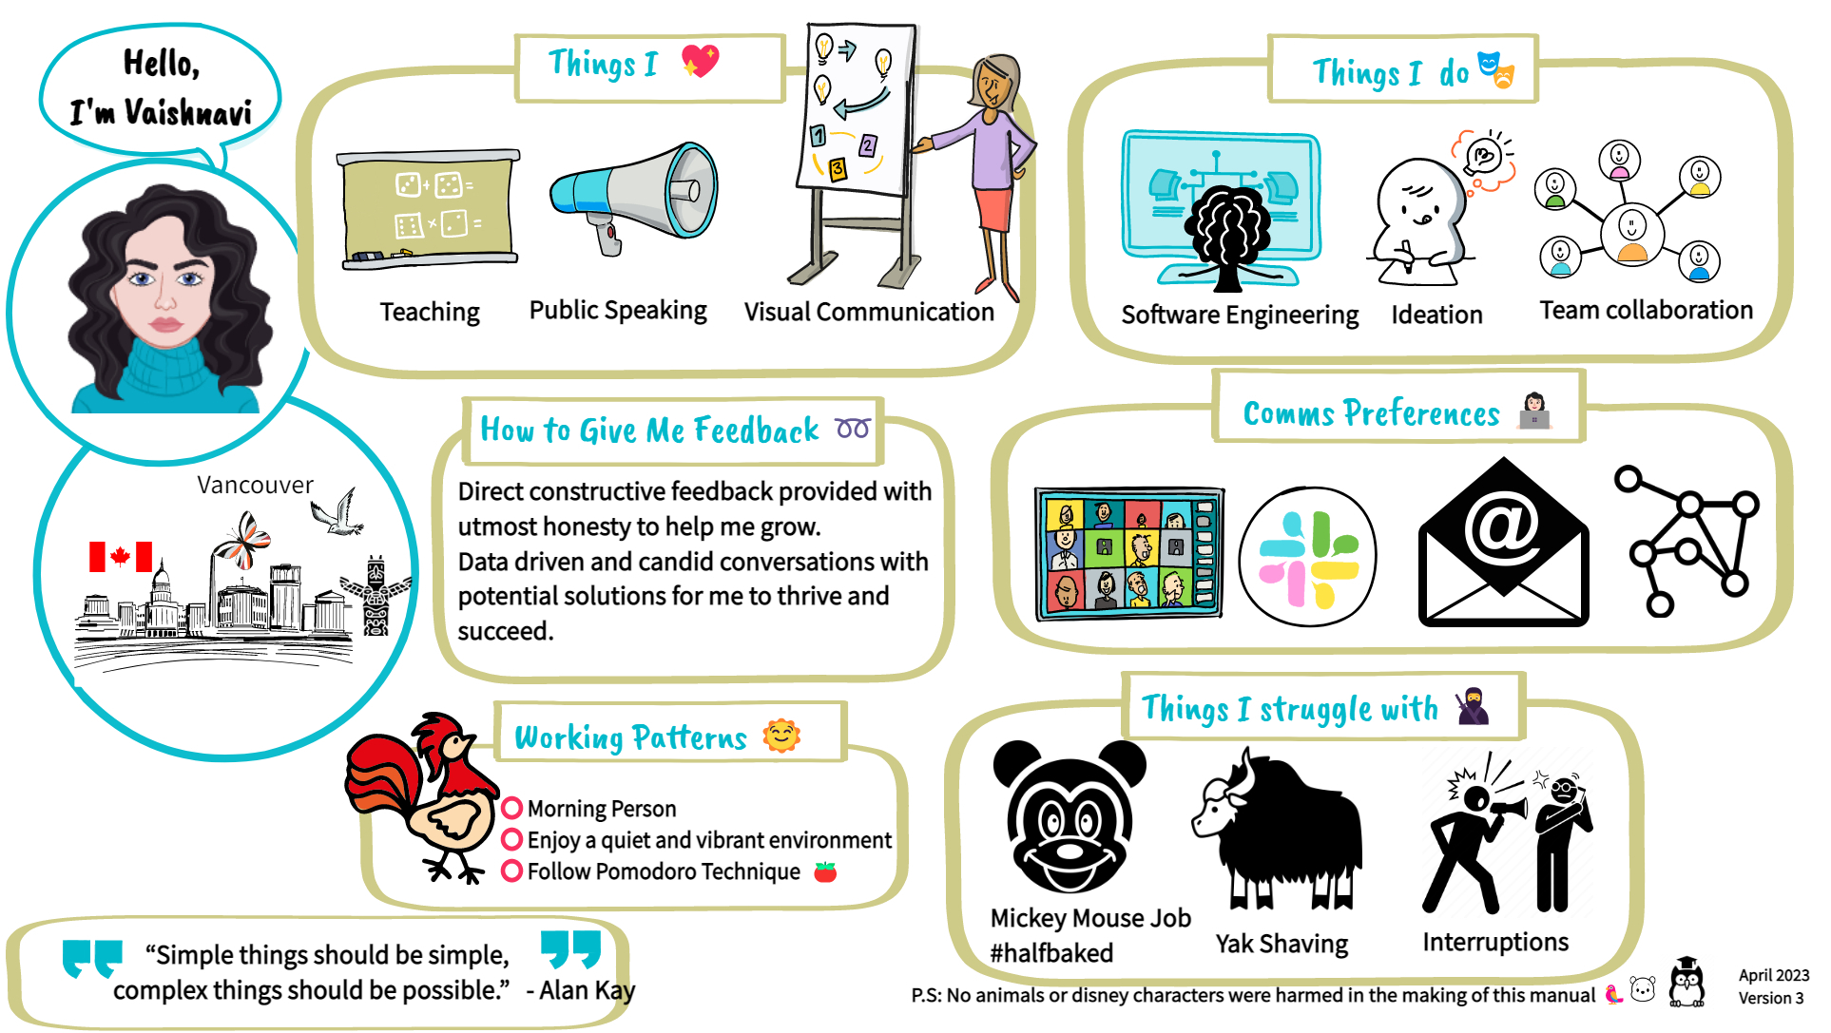

Slide 33
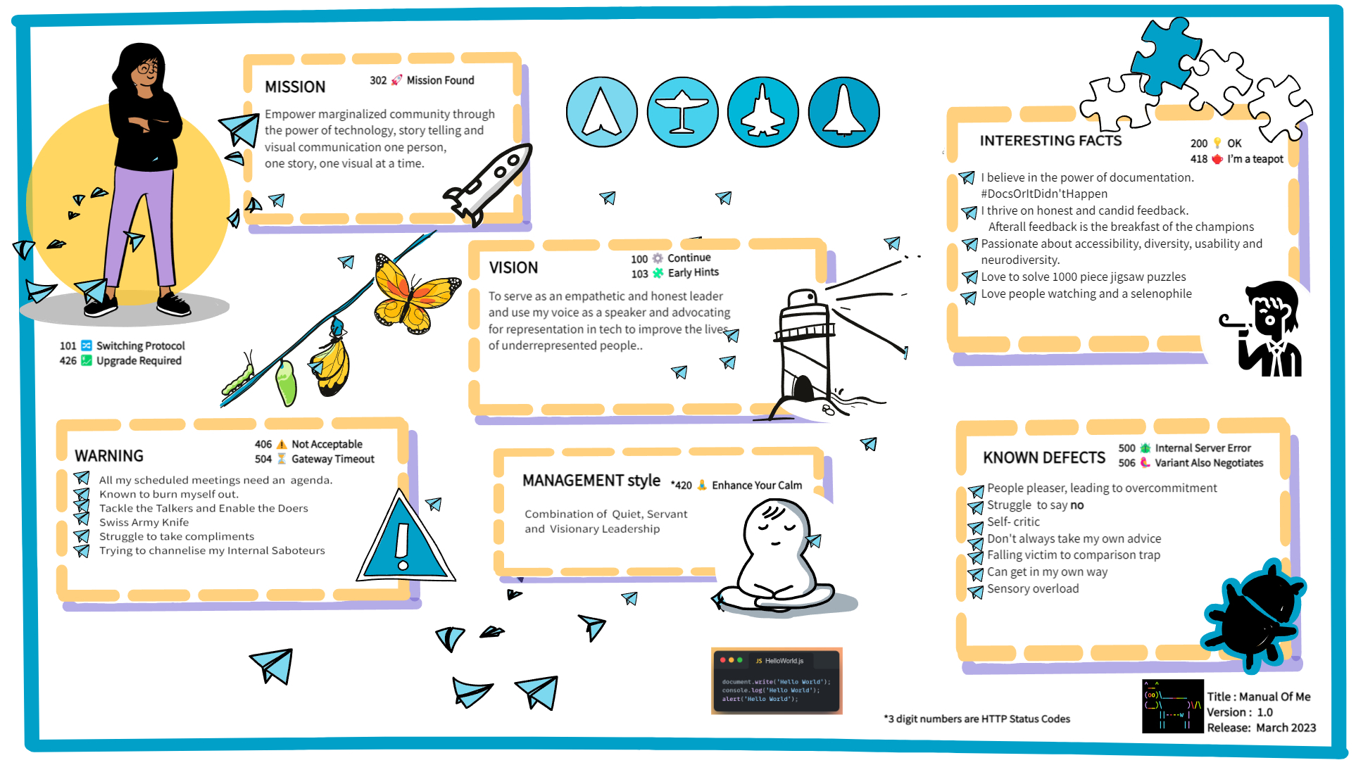
Meet the team

Slide 34
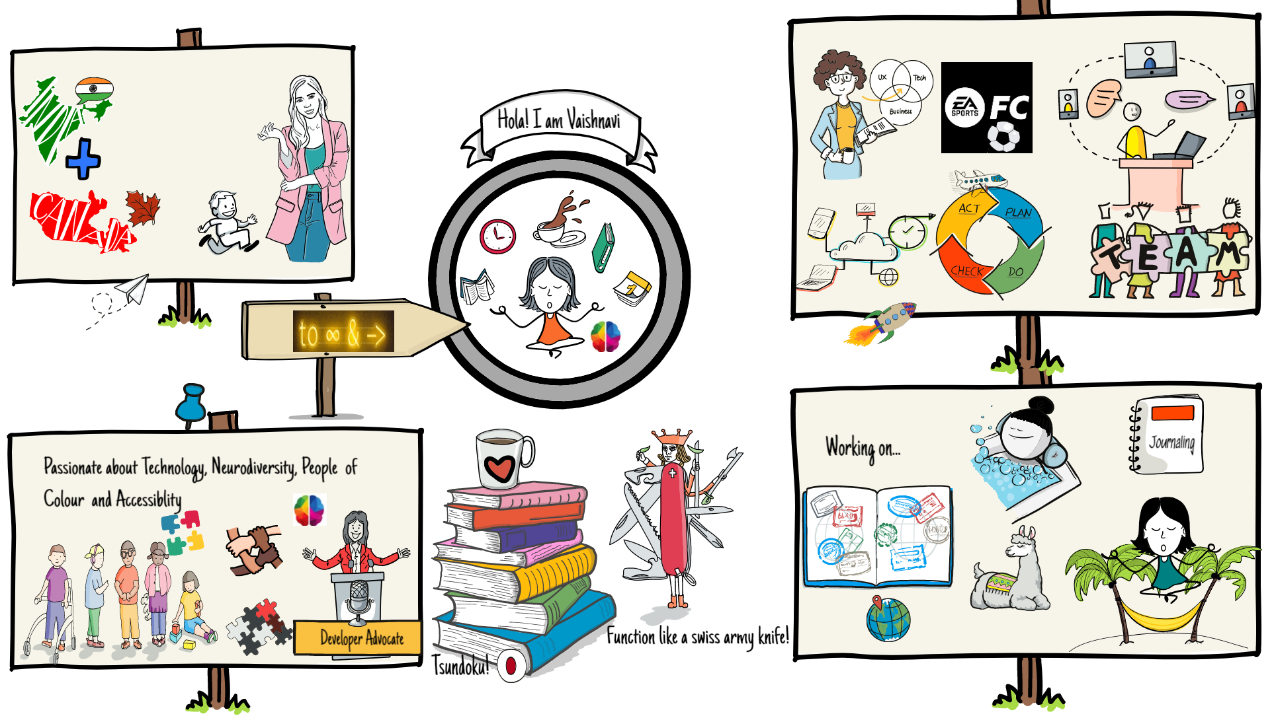
Meet the team

Slide 35
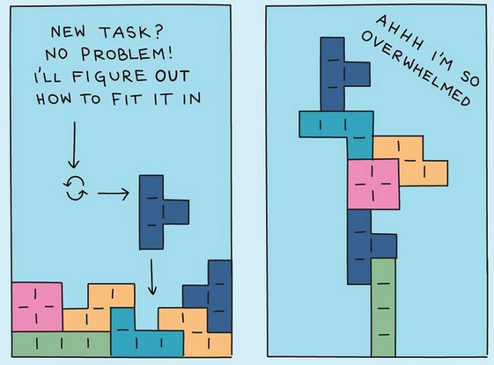
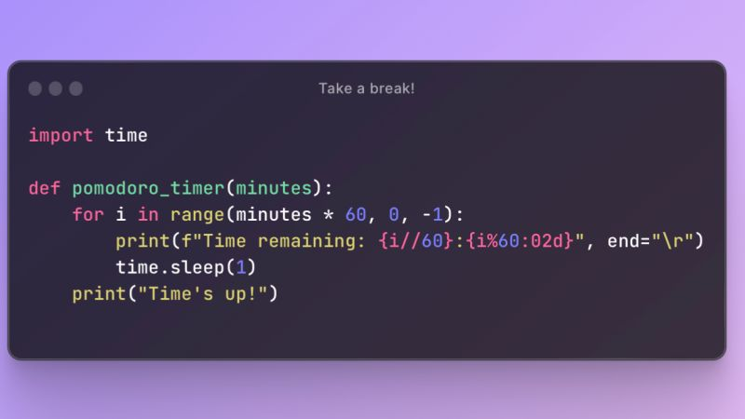

Ideas
$3B
$2B
$ 1B
Opportunity to build
Fully inclusive market
Total addressable market
Freedom to invent
Selectively inclusive market
Serviceable available market
Few competitors
Specifically targeted market
Serviceable obtainable market

Slide 36
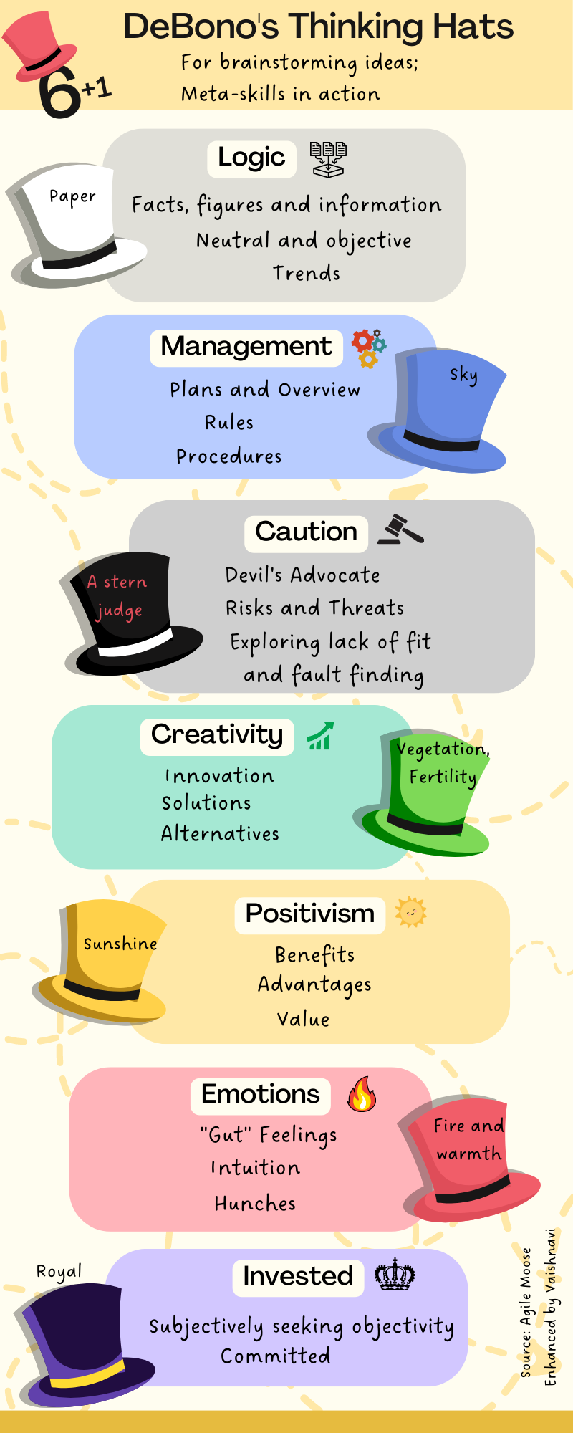

Slide 37
Resources
Plant UML
Waysfinder Framework
The Waysfinder provides a scaffold that enables new thinking and practice, not a series of linear steps. It is made up of a combination of various types of constraints and wayfinding practices that collectively create a coherent adaptive space or search field.

Slide 38
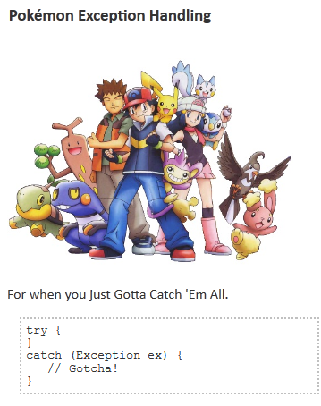

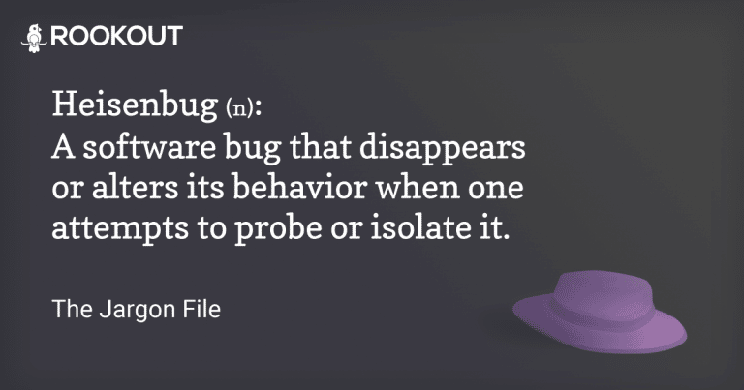

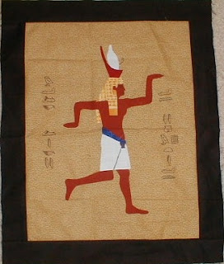

Programmer Jargon

Slide 39
Precaution

Slide 40

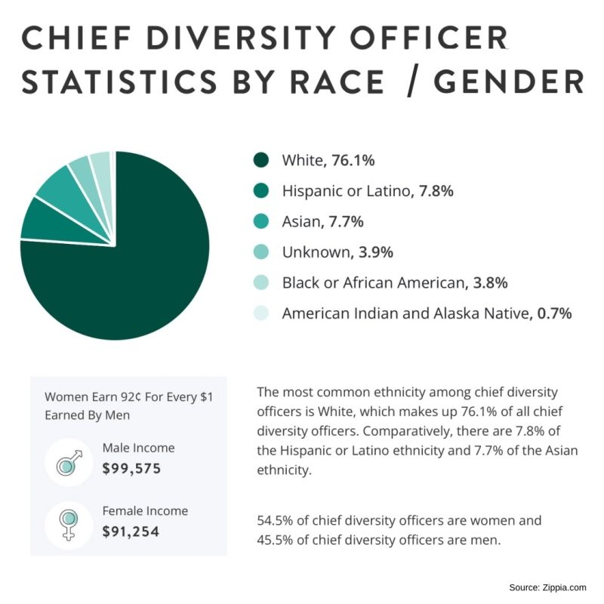
Overwhelming the user!

Slide 41
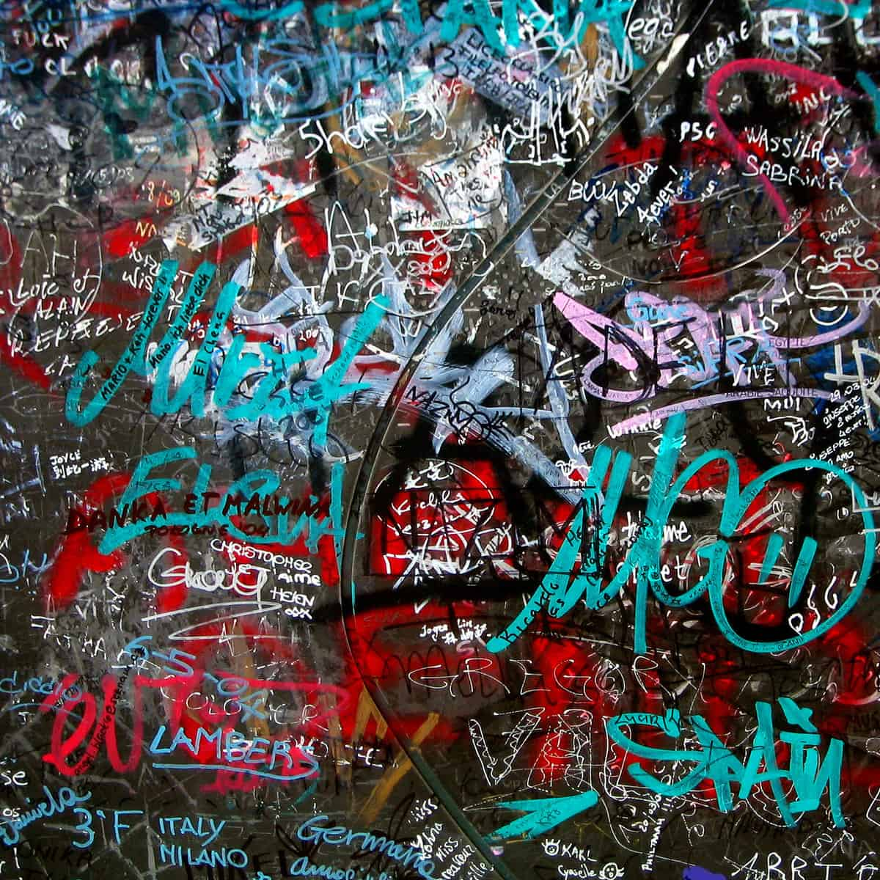
Clutter
Copyright: .marqs / photocase.com

Slide 42

Colors alone
Inaccessible
Red-green color blind?
Course # | Name
Algo 101 | Introduction to Algorithms
Networking 101 | Topology and Networking
Gardening 101 | Soil therapy for beginners

Slide 43
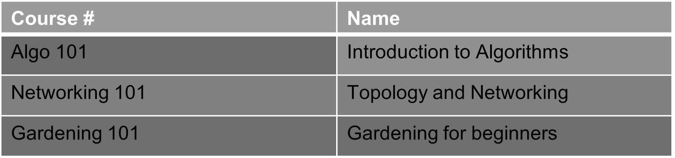
Colors alone!

Slide 44

Alternate means of communication
Accessible Example
Course # | Name | Required
Algo 101 | Introduction to Algorithms | Yes
Networking 101 | Topology and Networking | No
Gardening 101 | Gardening for beginners | No

Slide 45


Misinterpretation or reading between the lines?

Slide 46
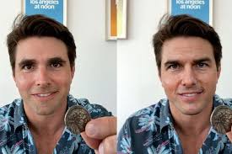
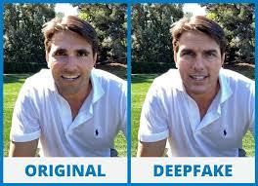
Deepfake technology: seeing is believing, or is it?

Slide 47
“Don’t tell me the moon is shining. Show me the glint of light on broken glass.”
- Anton Checkhov
Notes:
“Don’t tell me the moon is shining. Show me the glint of light on broken glass.” - Anton Checkhov

Slide 48
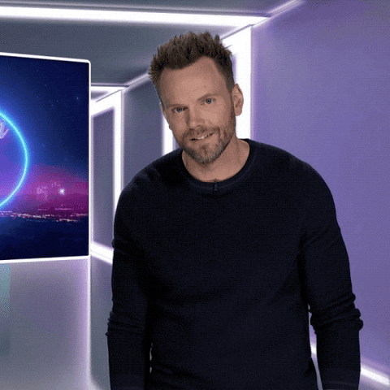


Slide 49


Slide 50
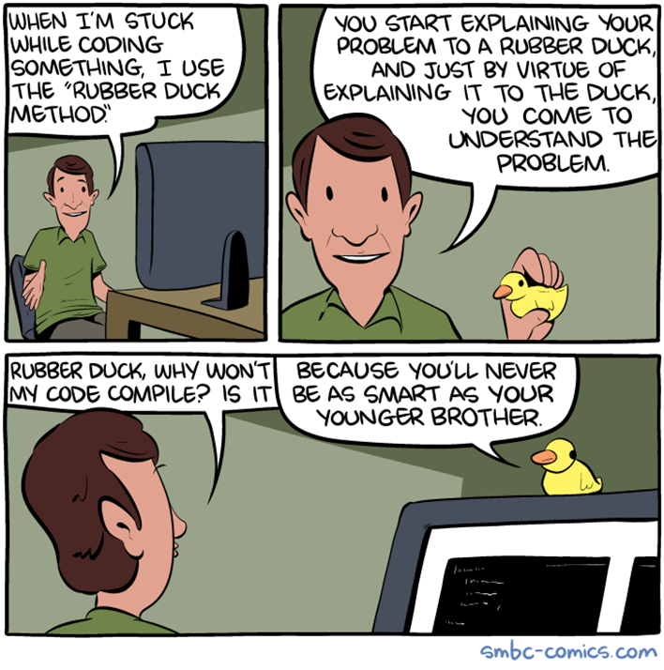

Slide 51

Be healthy both mentally and physically

Slide 52


